Slide 1
Research Updates:
Objective 1
Survival of Salmonella on Biodegradable Mulch, Landscape Fabric, and Plastic Mulch
Notes:
Introduce the presentation topic: "Survival of Salmonella on Biodegradable Mulch, Landscape Fabric, and Plastic Mulch."
Mention the overarching research objective and the importance of understanding pathogen behavior on various ground covers used in agriculture and landscaping.
Briefly acknowledge the USDA Specialty Crops Research Initiative for funding this study.

Slide 2
Research Highlights
Daily Salmonella die-off rate differed across tested ground covers.
Salmonella die-off followed bi- or tri-phasic patterns on tested ground covers.
Biodegradable mulch had the lowest Salmonella reduction 0 to 30 days post-inoculation (dpi).
Landscape fabric had the lowest Salmonella reduction at 140 dpi.
By 140 dpi, Salmonella reduction was >5 log on all ground cover materials.
Notes:
Highlight that Salmonella die-off rates varied significantly among tested ground covers.
Explain the observed bi- or tri-phasic die-off patterns.
Emphasize the slowest reduction of Salmonella occurred on biodegradable mulch within the first 30 days post-inoculation (dpi), and on landscape fabric by 140 dpi.
By 140 dpi, all materials exhibited over a 5-log reduction in Salmonella.

Slide 3
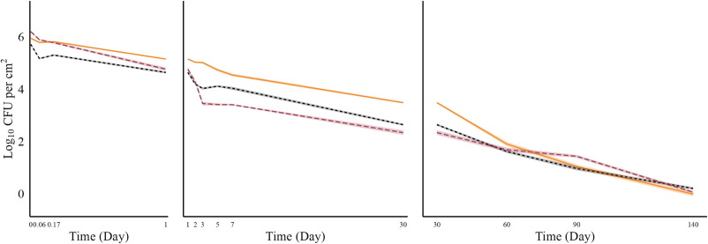
Mean log CFU/cm² of Salmonella over 0 to 140 Days Enumerated on Tryptic Soy Agar with Rifampicin
During the first 30 dpi, biodegradable mulch exhibited the smallest reduction in Salmonella, compared to landscape fabric and plastic mulch.
Biodegradable mulch - solid, yellow
Landscape fabric - dashed, black
Plastic mulch - long dashed, red
Notes:
Discuss the initial findings where biodegradable mulch showed the smallest reduction in Salmonella compared to landscape fabric and plastic mulch.
Mention that these results indicate a potential for extended survival of pathogens on biodegradable mulch early in the study.
Interpret the visual cues (solid yellow, dashed black, long dashed red) to represent the different ground cover materials.

Slide 4
Mean log CFU/cm² of Salmonella over 0 to 140 Days Enumerated on Tryptic Soy Agar with Rifampicin
After 60 dpi, Salmonella reductions stabilized across all materials and by 90 dpi, no significant differences were observed between ground cover types.
Biodegradable mulch - solid, yellow
Landscape fabric - dashed, black
Plastic mulch - long dashed, red
Notes:
Highlight that after 60 dpi, reductions in Salmonella became stable across all tested materials.
Point out that by 90 dpi, differences between ground covers were not statistically significant.
Stress the importance of long-term pathogen monitoring to ensure effective mitigation strategies.

Slide 5
Mean log CFU/cm² of Salmonella over 0 to 140 Days Enumerated on Tryptic Soy Agar with Rifampicin
Survival rates at 140 dpi were highest on landscape fabric followed by plastic mulch and biodegradable mulch coupons.
Salmonella survived 140 dpi on all tested ground covers, with reductions
>5 log CFU/cm².
Biodegradable mulch - solid, yellow
Landscape fabric - dashed, black
Plastic mulch - long dashed, red
Notes:
Explain the survival trends at 140 dpi, where landscape fabric showed the highest residual Salmonella levels.
Reiterate the reduction exceeding 5-log CFU/cm² on all ground covers.
Suggest implications for pathogen risk assessment in agricultural settings using these materials.

Slide 6
Average Salmonella Concentration (log CFU/cm²) Over 140 Days for Biodegradable Mulch, Landscape Fabric, and Plastic Mulch
Growth of Salmonella was not observed at any point during the study duration.
Although a statistical difference was detected in the initial (0 dpi) inoculum concentrations of the tested ground covers, the difference in die-off is not biologically significant with small variation across samples.
Notes:
Summarize the consistent lack of Salmonella growth throughout the study.
Clarify that while initial inoculum differences were statistically significant, their biological impact was minimal.
Discuss the practical significance of findings for growers and land managers using these materials.

Slide 7


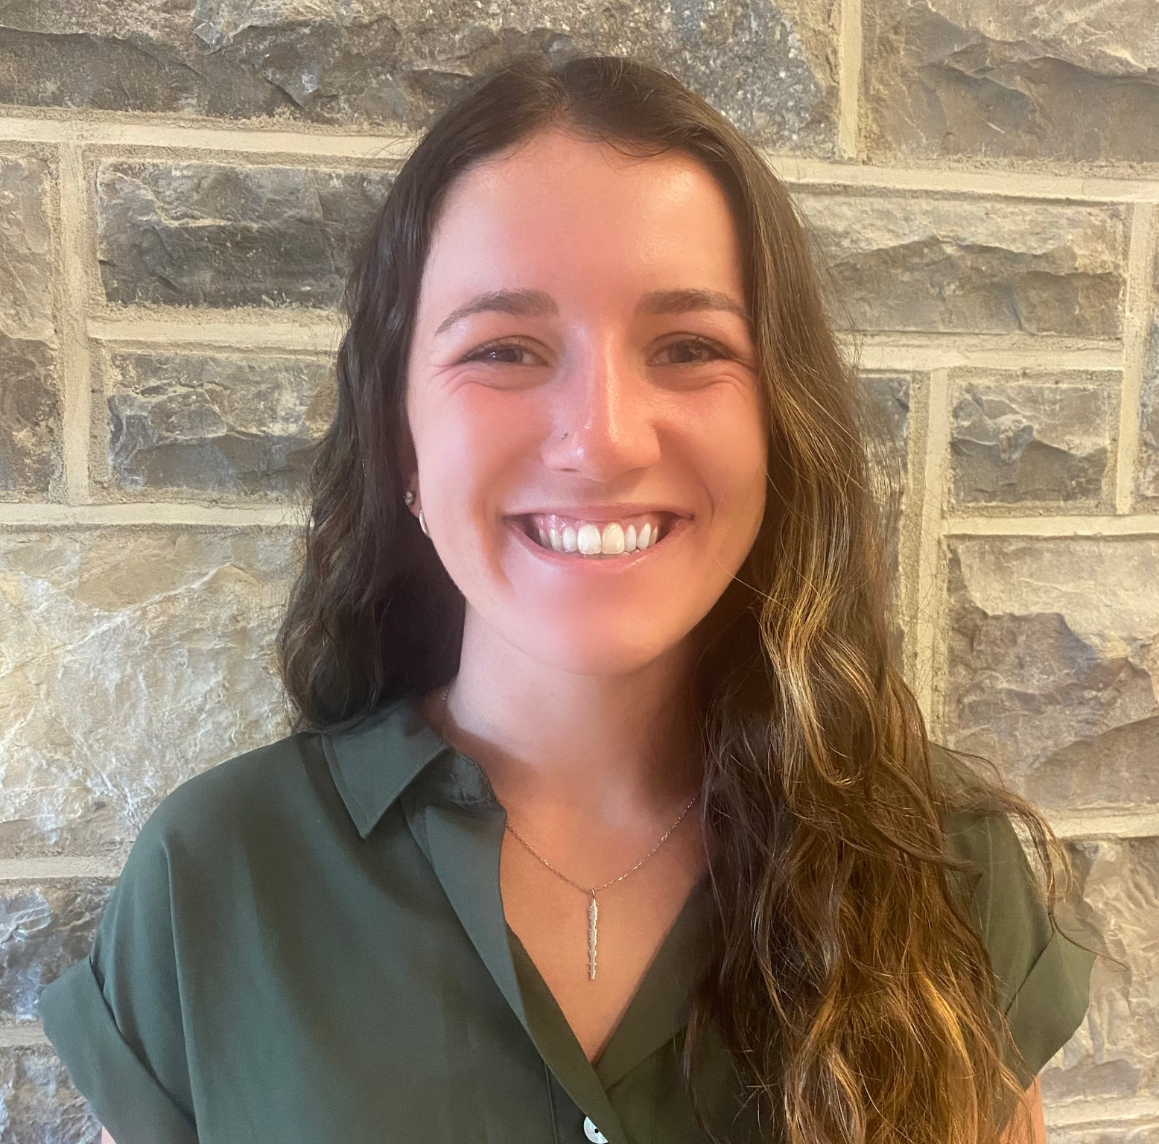
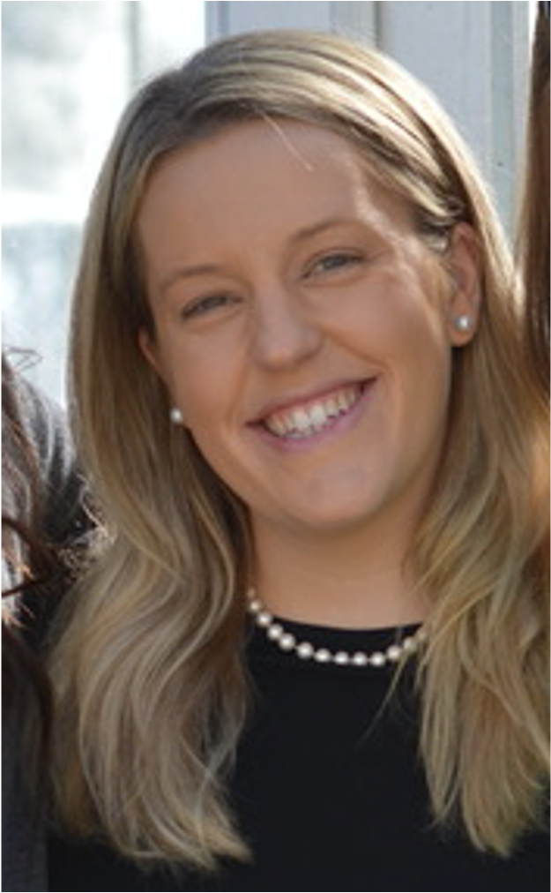

More Information
Check out our paper!
Alyssa A. Rosenbaum
Graduate Research Associate
University of Arizona
alyssaar@arizona.edu
Laura K. Strawn, Ph.D.
Associate Professor
Virginia Tech
laurakstrawn@vt.edu
This work is supported by the Specialty Crops Research Initiative [grant no. 2020-51181-32157] from the USDA National Institute of Food and Agriculture. Any opinions, findings, conclusions, or recommendations expressed in this presentation are those of the speakers and do not necessarily reflect the view of the U.S. Department of Agriculture.
Notes:
Share the contact details of the researchers (Alyssa A. Rosenbaum and Dr. Laura K. Strawn) for further inquiries.
Encourage the audience to access the paper for detailed data and methodology.
Thank the USDA and acknowledge the funding source once again.

