Slide 1
Research Updates: Objective 1
Sanitizer Type and Contact Time Influence Salmonella Reductions in Preharvest Agricultural Water Used on Virginia Farms
Notes:
Introduce the topic: Preharvest agricultural water can be a source of Salmonella contamination.
Outline the research objectives: Evaluate how sanitizer type and contact time influence Salmonella reductions.
Mention significance: These findings help improve food safety practices in agriculture.

Slide 2
Research Highlights
Salmonella reductions were evaluated in agriculture water treated with sanitizers.
Sanitizer type and contact time were strongly associated with Salmonella reductions.
Outbreak strains were more treatment-resistant than environmental strains.
Varying volumes of sanitizers were needed to reach target ppm in the water sources.
Effective treatment requires accounting for water quality to ensure valid dosing
Notes:
Discuss evaluation of Salmonella reductions in water treated with sanitizers.
Note the critical factors:
Sanitizer type and contact time strongly influence effectiveness.
Outbreak strains are more resistant than environmental strains.
Sanitizer dosing depends on water quality.

Slide 3
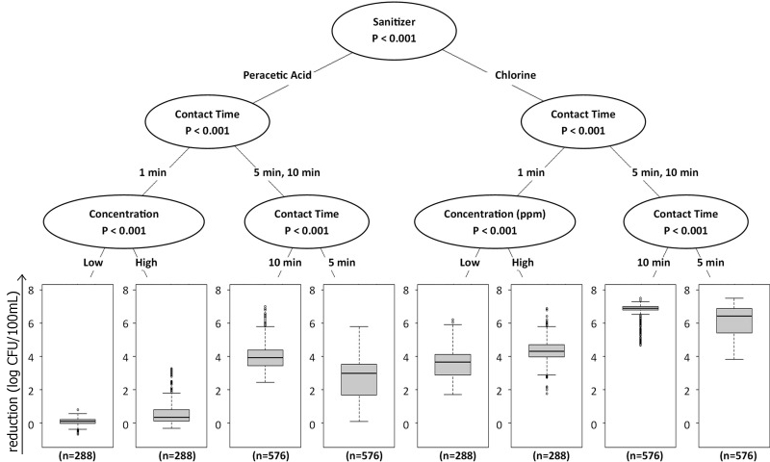
Effect of interactions between factors on Salmonella reductions
The sanitizer used for treatment had the largest effect on population reductions, with chlorine showing a greater reduction in Salmonella than peracetic acid.
Contact time also had a significant impact, with higher contact time showing greater reduction in population.
Notes:
Highlight chlorine's superior performance compared to peracetic acid.
Emphasize the importance of longer contact times for higher Salmonella reductions.

Slide 4
Effect of interactions between factors on Salmonella reductions
The strain set did impact treatment, with outbreak strains showing more treatment-resistance than environmental strains.
Using a high-concentration of sanitizer had a greater effect than a low concentration and using a higher water temperature had a greater reduction compared to low-temperature water.
Notes:
Discuss differences in treatment resistance:
Outbreak strains are harder to treat than environmental strains.
Note the role of sanitizer concentration:
Higher concentrations are more effective.
Water temperature influences results; higher temperatures enhance reductions.

Slide 5
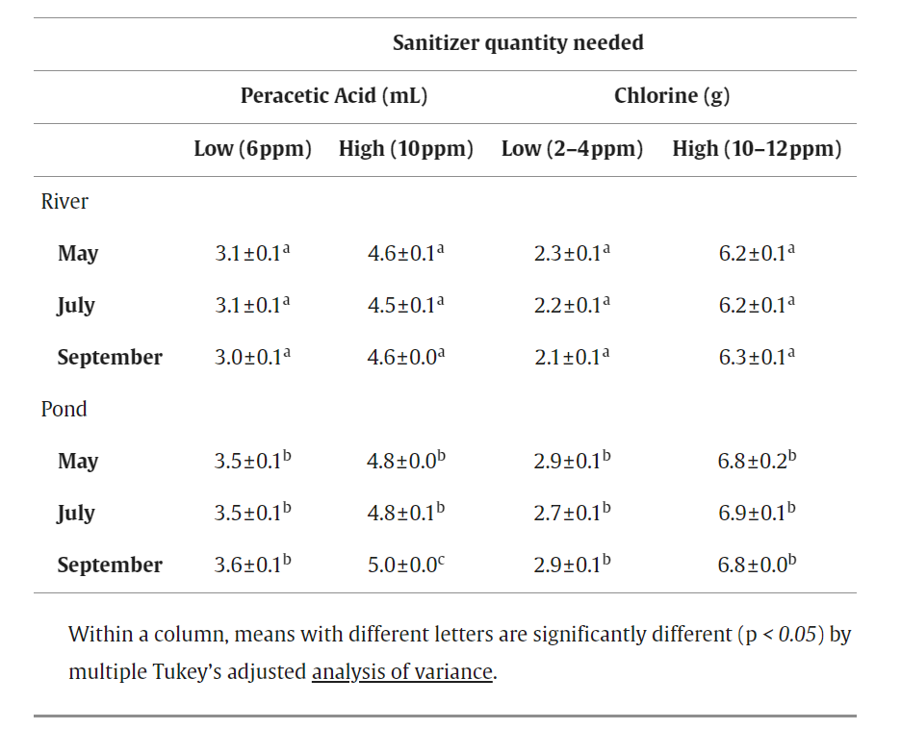
Sanitizer Quantity Needed
The volume of sanitizer needed to reach the desired ppm differed between the water types, with the pond water always requiring significantly more sanitizer volume, compared to the river water.
Notes:
Discuss volume requirements for effective treatment:
Pond water consistently requires more sanitizer than river water.
Quality and temperature of water affect the volume and efficacy of sanitizers.

Slide 6
Sanitizer Quantity Needed
Since the temperature and water quality of preharvest agricultural water can fluctuate over space and time and are interdependent with sanitizer efficacy, these parameters should be evaluated prior to and monitored during treatment.
Notes:
Stress the need to assess and monitor water quality and temperature before treatment.
Highlight interdependence of these factors with sanitizer efficacy.

Slide 7
More Information
Check out our paper!
Claire M Murphy, Ph.D.
Assistant Professor and Extension Specialist
Washington State University
claire.murphy@wsu.edu
Laura K. Strawn, Ph.D.
Associate Professor
Virginia Tech
laurakstrawn@vt.edu
This work is supported by the Specialty Crops Research Initiative [grant no. 2020-51181-32157] from the USDA National Institute of Food and Agriculture. Any opinions, findings, conclusions, or recommendations expressed in this presentation are those of the speakers and do not necessarily reflect the view of the U.S. Department of Agriculture.
Notes:
Acknowledge funding from the USDA's Specialty Crops Research Initiative.
Provide contact details for Dr. Claire M. Murphy and Dr. Laura K. Strawn for further queries.
Encourage the audience to read the related paper for detailed findings.

