Slide 1
Research Updates: Objective 4
Development and Evaluation of a Modified Most Probable Number (MPN) Method for Enumerating Rifampicin-resistant Escherichia coli in Agricultural, Food, and Environmental Samples
Notes:
Introduce the research objective: developing and evaluating a modified Most Probable Number (MPN) method.
Explain the focus on enumerating rifampicin-resistant Escherichia coli in agricultural, food, and environmental samples.

Slide 2
Research Highlights
Low level of rifampicin-resistant E. coli is typically enumerated using traditional Most Probable Number (MPN) method.
To simplify the process, we developed and validated a modified MPN method based on lactose peptone broth (LPB) containing rifampicin and bromocresol purple.
The broth changes to a yellow color due to pH shifts induced by lactose fermentation from E. coli.
Confirmation results generated from this new color change MPN method were analogous to traditional MPN methods.
Notes:
Traditional MPN methods are used to enumerate low levels of rifampicin-resistant E. coli.
A modified MPN method was developed using lactose peptone broth (LPB) with rifampicin and bromocresol purple as indicators.
The method simplifies the detection process with a color change (yellow) due to pH shifts from lactose fermentation.
Validation results show high consistency with traditional MPN methods.

Slide 3
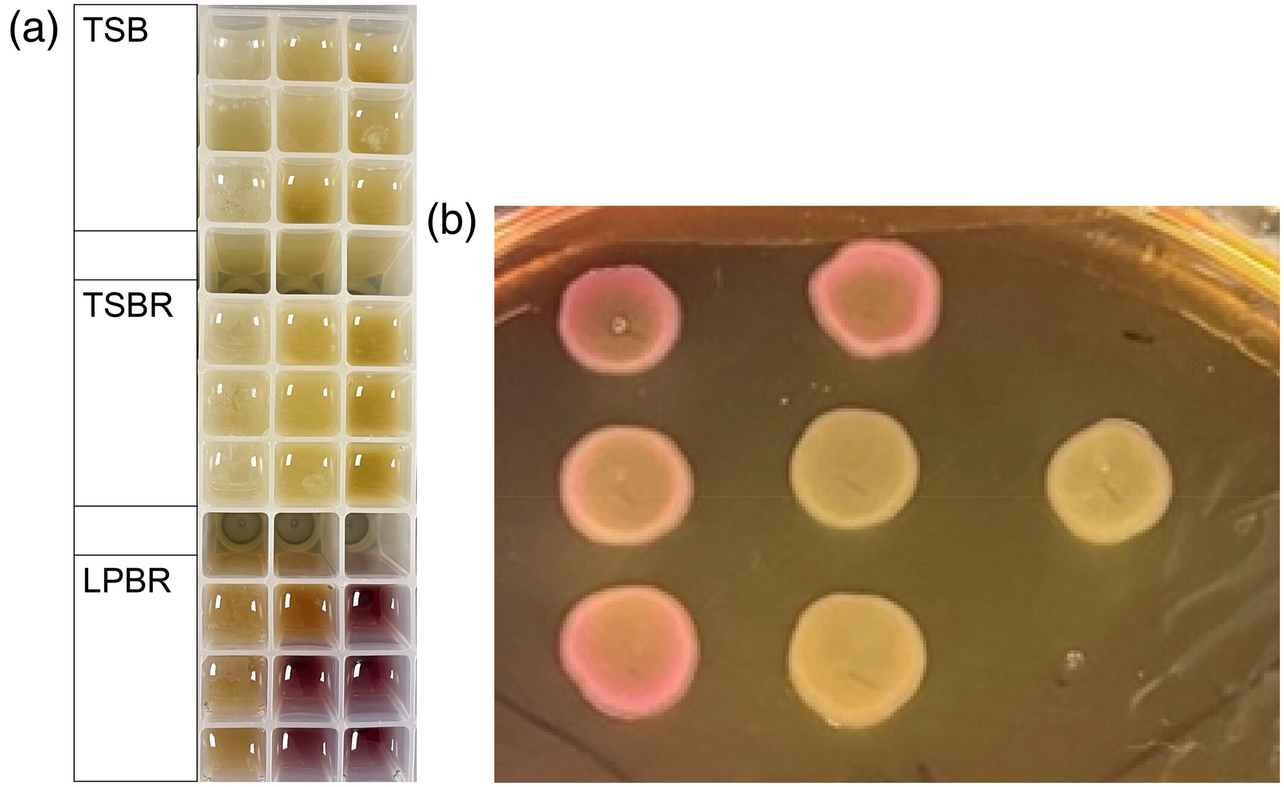
Determination of Bacterial Populations
Due to lactose fermenting characteristics, E. coli TVS353 was confirmed as pink colonies on MACR, and other colored colonies were considered as rifampicin-resistant background flora.
Notes:
E. coli TVS353 colonies are identified by their pink color on MACR plates.
Other colonies are classified as rifampicin-resistant background flora.
Highlight the importance of distinguishing target bacteria from background flora.

Slide 4
Determination of Bacterial Populations
LPBR exhibited a significant advantage over the TSBR-P MPN assay: it specifically enriched E. coli TVS353 over other background microflora, and the color change enabled direct visualization of the results, all in the same growth step.
Notes:
LPBR has a significant advantage over TSBR-P MPN assays:
Enhanced specificity for E. coli TVS353.
Simultaneous visualization of results through color changes in the same growth step.
Discuss the operational benefits of LPBR for bacterial enumeration.

Slide 5
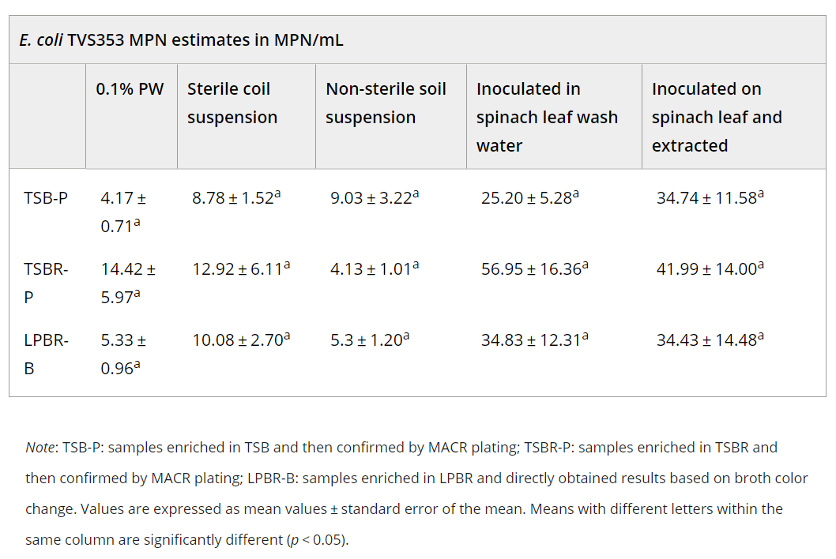
Application of Simulated Environmental Samples with the New MPN Method
MPN results generated from the three broths showed no significant differences. The results consistently demonstrated high comparability of LPBR and TSBR/MACR MPN methods in fresh produce samples.
Notes:
MPN results from LPBR, TSBR, and MACR broths show no significant differences.
The consistency of results confirms the reliability of the modified MPN method in fresh produce samples.
Discuss the practical implications for field and lab settings.

Slide 6
Application of Simulated Environmental Samples with the New MPN Method
The MPN estimate results from various conditions of E. coli TVS353 suspensions in multiple testing substances proved the LPBR MPN assay to be highly accurate and specific in detecting and enumerating E. coli TVS353.
Notes:
The LPBR MPN assay demonstrated high accuracy and specificity in various simulated conditions.
Highlight its effectiveness in detecting and enumerating E. coli TVS353 across multiple substrates.
Stress the potential for broader applications of this method.

Slide 7
More Information
Check out our paper!
Zhujun Gao
Research Assistant
University of Maryland
abbygao@umd.edu
Rohan V. Tikekar
Associate Professor/Extension Specialist
University of Maryland
rtikekar@umd.edu
This work is supported by the Specialty Crops Research Initiative [grant no. 2020-51181-32157] from the USDA National Institute of Food and Agriculture. Any opinions, findings, conclusions, or recommendations expressed in this presentation are those of the speakers and do not necessarily reflect the view of the U.S. Department of Agriculture.
Notes:
Acknowledge funding from the USDA’s Specialty Crops Research Initiative.
Clarify that the findings and conclusions are those of the authors.
Provide contact details for Zhujun Gao and Rohan V. Tikekar for further inquiries.
Encourage the audience to review the published paper for additional details.

