Slide 1
Research Updates: Objective 1
Evaluation of Aqueous Chlorine and Peracetic Acid Sanitizers to Inactivate Protozoa and Bacteria of Concern in Agricultural Water
Notes:
Introduce the topic: "Evaluation of Aqueous Chlorine and Peracetic Acid Sanitizers to Inactivate Protozoa and Bacteria of Concern in Agricultural Water."
Highlight the importance of this research in improving agricultural water safety.
Mention the affiliations: University of Delaware and USDA Specialty Crops Research Initiative.

Slide 2
Research Highlights
Low and high concentrations of sanitizer were effective at eliminating bacteria with Cl being significantly more effective.
The greatest reductions in E. coli and Salmonella were observed after 10 minutes of exposure to 10 ppm Cl.
Concentrations of sanitizer 50 ppm and lower resulted in insignificant reductions in parasite infectivity of less than 1 log for both organisms.
A 200 ppm PAA treatment reduced infectious oocyst populations by 3.8 log for C. parvum and 2.6 log for E. tenella, with Cl being significantly less effective against these organisms.
Notes:
Summarize the key findings:
Both low and high concentrations of sanitizers effectively eliminated E. coli and Salmonella.
Chlorine (Cl) showed higher effectiveness, especially at 10 ppm with 10-minute exposure.
For parasites (C. parvum and E. tenella), low sanitizer concentrations were less effective.
A 200 ppm PAA treatment significantly reduced oocyst infectivity (3.8 log for C. parvum, 2.6 log for E. tenella).
Emphasize the contrast between bacterial and protozoal reductions.

Slide 3
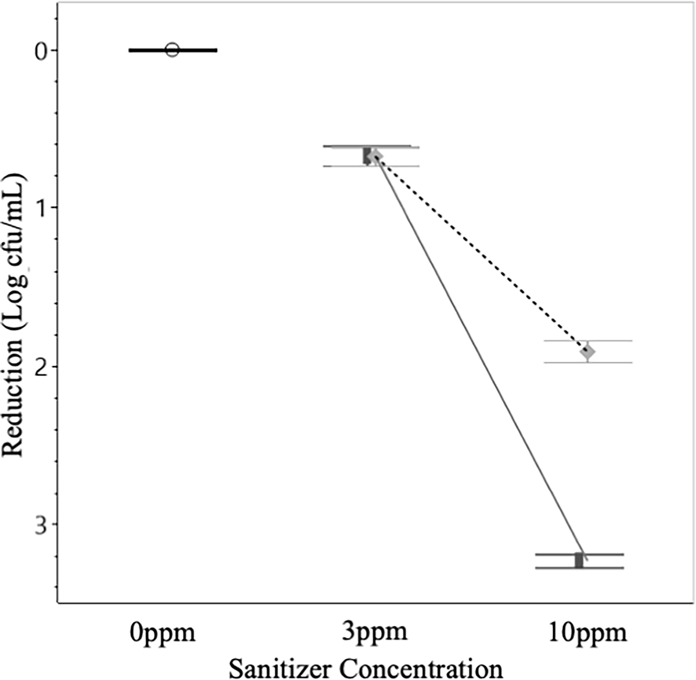
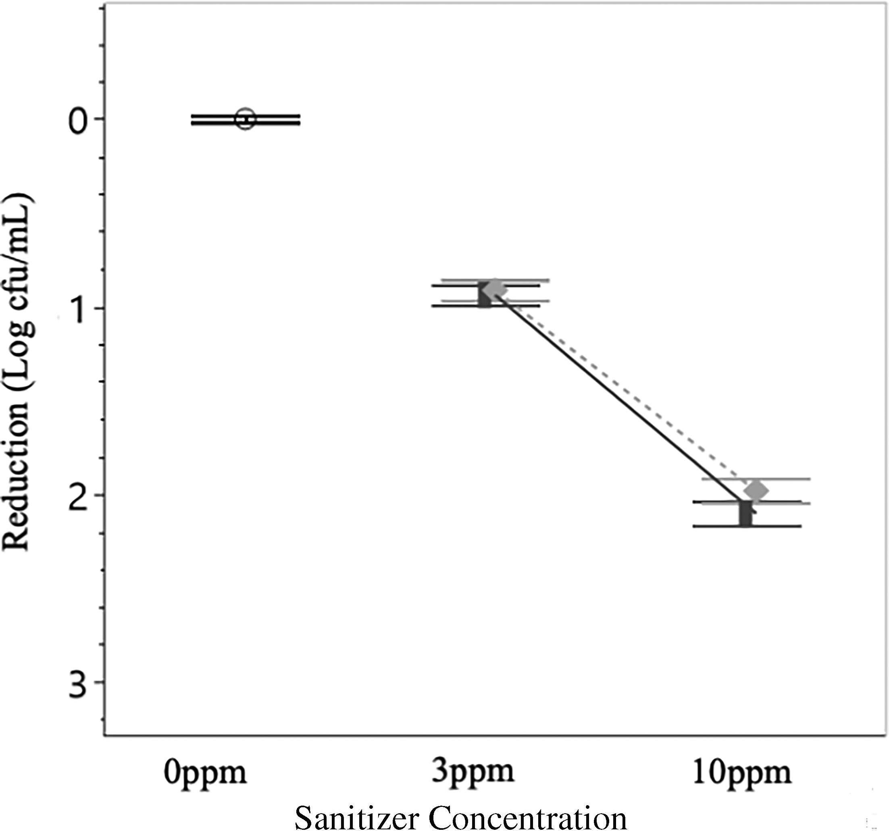
Bacterial Reduction – E. coli and Salmonella
E. coli Reduction
Salmonella Reduction
Given 10 minutes of contact, low concentrations of sanitizer were effective at eliminating E. coli and Salmonella, with neither chlorine (Cl) nor peracetic acid (PAA) being significantly more effective.
solid line and █ = Cl
dotted line and ♦ = PAA
solid line and █ = Cl
dotted line and ♦ = PAA
Notes:
Highlight the results of sanitizer effectiveness on E. coli and Salmonella:
At low concentrations, both sanitizers (Cl and PAA) were effective at eliminating bacteria.
Cl and PAA did not show significant differences at these levels.
Point out the exposure time: 10 minutes.
Direct the audience to the graphical data for clarity.

Slide 4
Bacterial Reduction – E. coli and Salmonella
E. coli Reduction
Salmonella Reduction
When applied at a concentration of 10 ppm, the sanitizers were significantly more effective, albeit indistinct from one another, at reducing Salmonella.
However, Cl outperformed PAA substantially at reducing E. coli.
solid line and █ = Cl
dotted line and ♦ = PAA
solid line and █ = Cl
dotted line and ♦ = PAA
Notes:
Discuss the performance of sanitizers at 10 ppm concentration:
Both sanitizers were highly effective against Salmonella.
However, Cl performed significantly better at reducing E. coli compared to PAA.
Reiterate the practical implications for agricultural water treatment.
Guide the audience through the graphical comparisons.

Slide 5
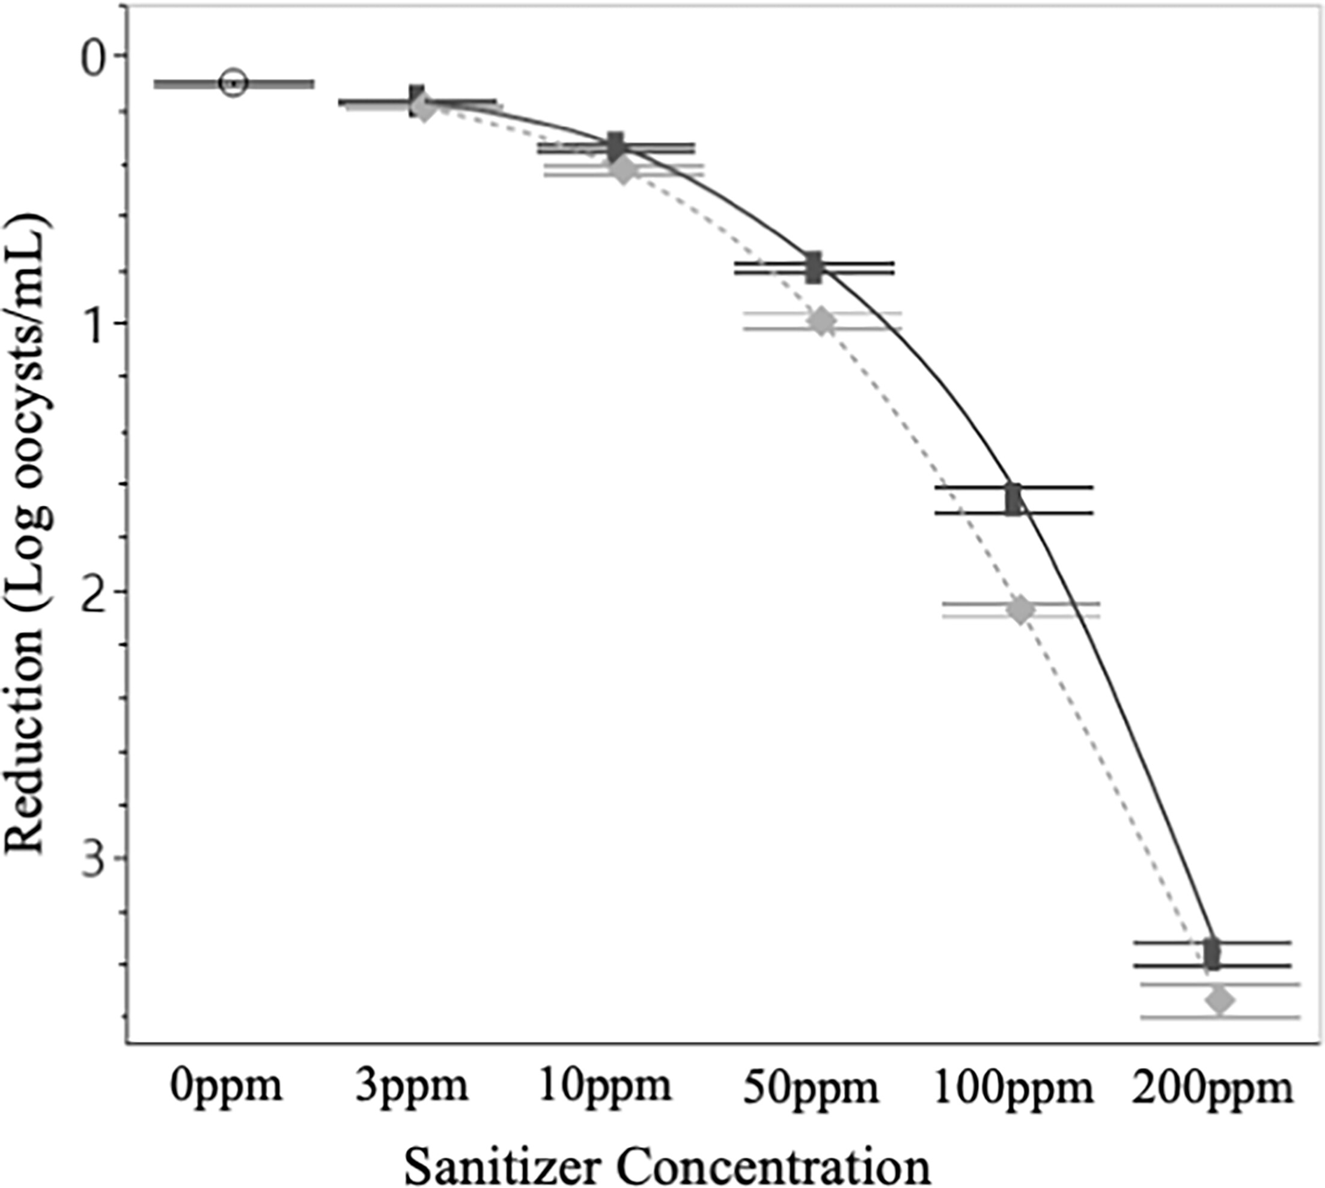
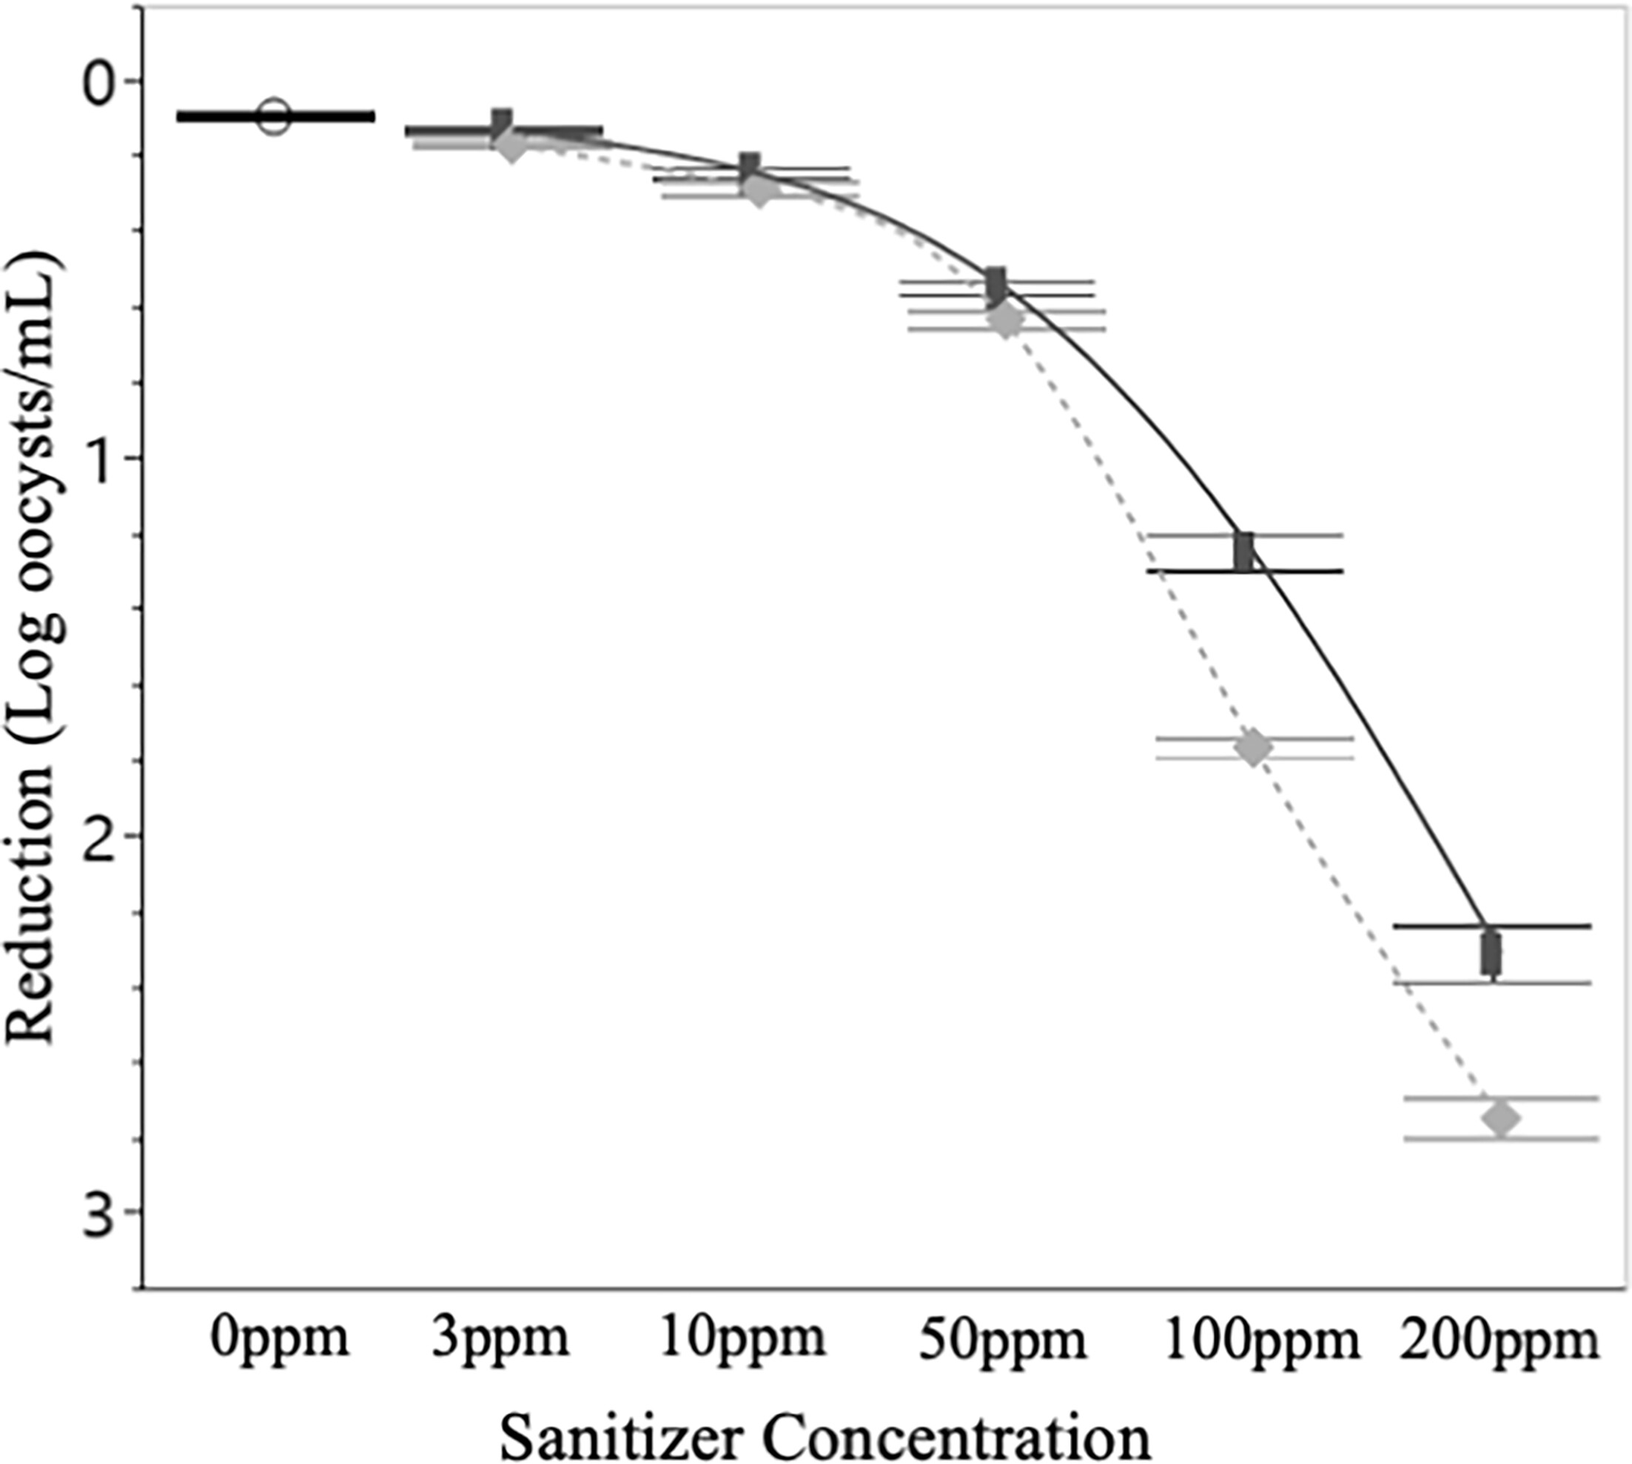
Oocyst inactivation - C. parvum and E. tenella
C. parvum Inactivation
E. tenella Inactivation
Treating C. parvum and E. tenella oocysts with 3 or 10 ppm of sanitizer was ineffective at decreasing infectivity regardless of 5 or 10-minute contact time.
solid line and █ = Cl
dotted line and ♦ = PAA
solid line and █ = Cl
dotted line and ♦ = PAA
Notes:
Highlight the challenges with protozoa inactivation:
Treating oocysts with 3 or 10 ppm of sanitizer was ineffective in reducing infectivity, regardless of contact time (5 or 10 minutes).
Explain that this result indicates higher sanitizer concentrations may be necessary for protozoa control.

Slide 6
Oocyst inactivation - C. parvum and E. tenella
C. parvum Inactivation
E. tenella Inactivation
In general, treatment with PAA was more effective at inactivating C. parvum and E. tenella oocysts as compared to Cl, but this difference was not always significant.
solid line and █ = Cl
dotted line and ♦ = PAA
solid line and █ = Cl
dotted line and ♦ = PAA
Notes:
Explain that while PAA was generally more effective at inactivating oocysts than Cl, the differences were not always statistically significant.
Highlight the need for further research or optimized treatment protocols to address protozoa like C. parvum and E. tenella.

Slide 7
More Information
Check out our paper!
Kyle J. McCaughan
PHD Candidate
University of Delaware
Kalmia E. Kniel
Professor of Animal and Food Sciences
University of Delaware
kniel@udel.edu
This work is supported by the Specialty Crops Research Initiative [grant no. 2020-51181-32157] from the USDA National Institute of Food and Agriculture. Any opinions, findings, conclusions, or recommendations expressed in this presentation are those of the speakers and do not necessarily reflect the view of the U.S. Department of Agriculture.
Notes:
Acknowledge funding support from the USDA Specialty Crops Research Initiative grant.
Provide the contact details for further inquiries:
Kyle J. McCaughan (PhD Candidate, University of Delaware)
Kalmia E. Kniel (Professor, University of Delaware; Email: kniel@udel.edu)
Encourage the audience to check out the related published research paper for more in-depth information.

