Slide 1
Research Updates: Objective 4
Survey of Environmental Monitoring Practices in Fresh Produce Packinghouses
Notes:
Introduce the purpose of this research: a survey of environmental monitoring practices in fresh produce packinghouses.
Highlight the objective of understanding Environmental Monitoring Programs (EMP) and their implementation within the industry.

Slide 2
Research Highlights
Approximately 62.5% of produce packers who responded to the survey indicated they had an EMP.
ATP was the most common monitoring technique used for zone 1 surfaces
100% of produce packers with an EMP had corrective actions (CA) identified. 42% reported never needing to implement a CA
Notes:
Key findings from the survey:
62.5% of produce packers have an EMP in place.
ATP is the most commonly used monitoring technique for zone 1 surfaces.
100% of those with EMPs identified corrective actions (CA); however, 42% have never had to implement them.
Discuss what these findings suggest about EMP practices and their rigor in the industry.

Slide 3
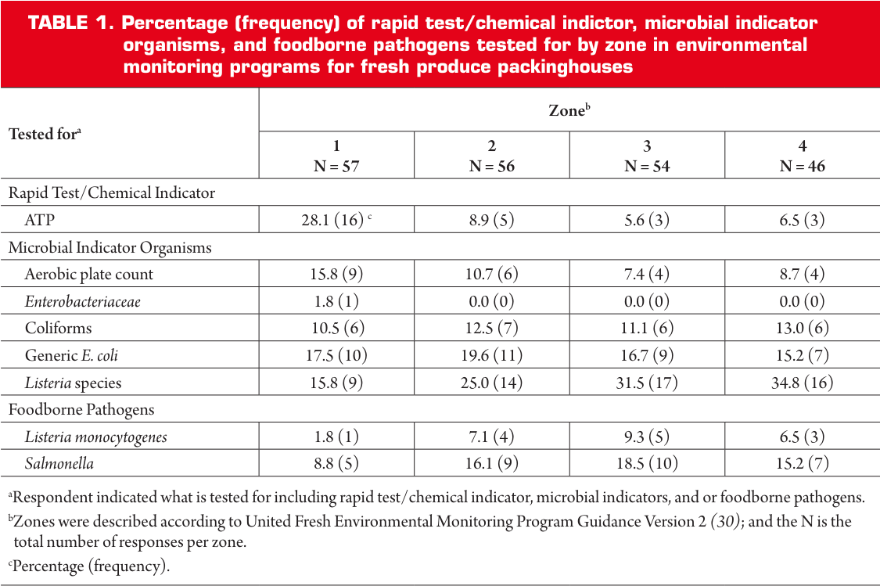
Frequency of Tests by Zone
Top 3 Tests by Zone:
Zone 1:
ATP
Generic E. coli
Aerobic Plate Count/Listeria Species
Zone 2:
Listeria Species
Generic E. coli
Salmonella
Zones 3 and 4:
Listeria Species
Salmonella
Generic E. coli
Notes:
Discuss the types of tests most frequently used in each zone:
Zone 1: ATP, generic E. coli, aerobic plate count, Listeria species.
Zone 2: Listeria species, generic E. coli, Salmonella.
Zones 3 & 4: Listeria species, Salmonella, generic E. coli.
Mention the trend of increased focus on pathogen-specific tests, particularly in zones 2-4.

Slide 4
Frequency of Tests by Zone
Approximately 62.5% of produce packers (40/62 packinghouse; 5/10 field-pack) who responded to the survey indicated they had an EMP. ATP was the most common monitoring technique used for zone 1 surfaces, followed by generic Escherichia coli, Listeria species, and aerobic plate counts. A shift was noted towards addition and greater reliance on pathogen targets (e.g., Salmonella) for zones 2-4.
Notes:
Provide additional details about testing practices:
Highlight the shift towards pathogen-specific monitoring methods in zones 2-4, such as targeting Salmonella.
Stress the importance of tailoring testing protocols to risk levels in different zones.

Slide 5
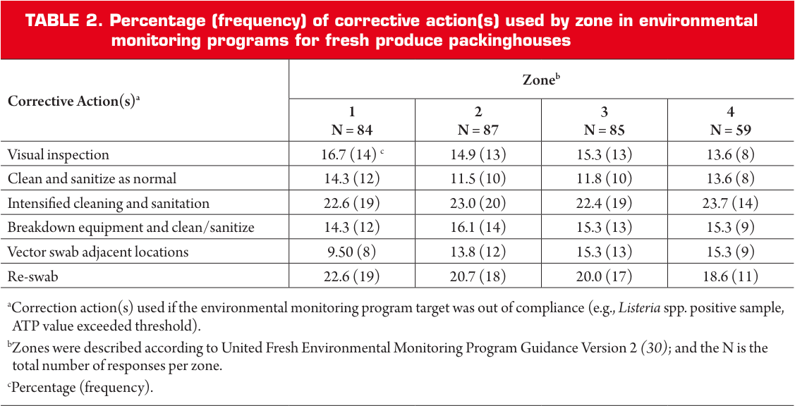
Frequency of Corrective Actions by Zone
Top 3 Corrective Actions by Zone:
Zone 1:
Intensified Cleaning and Sanitation
Re-swab
Visual Inspection
Zone 2:
Intensified Cleaning and Sanitation
Re-swab
Breakdown Equipment and Clean/Sanitize
Zone 3:
Intensified Cleaning and Sanitation
Re-swab
Visual Inspection, Breakdown Equipment and Clean/Sanitize, Vector Swab Adjacent Locations
Zone 4:
Intensified Cleaning and Sanitation
Re-swab
Breakdown Equipment and Clean/Sanitize, Vector Swab Adjacent Locations
Notes:
Highlight the common corrective actions by zone:
Zone 1: Intensified cleaning/sanitation, re-swabbing, visual inspection.
Zone 2: Similar corrective actions with added focus on equipment breakdown and cleaning/sanitization.
Emphasize how corrective actions are tailored to specific zones to address contamination risks effectively.

Slide 6
Frequency of Corrective Actions by Zone
While 100% of produce packers with an EMP had corrective actions (CA) identified, 42% reported never needing to implement a CA, suggesting produce packers were always in conformance. This result indicates a potential shortfall in EMP rigor, as occasional failures are expected.
Notes:
Discuss findings regarding the implementation of corrective actions:
Although all EMPs had CAs identified, 42% of respondents never needed to implement them.
Highlight potential shortcomings in EMP rigor, as occasional non-conformance is expected.
Stress the need for more robust monitoring and CA protocols to ensure EMP effectiveness.

Slide 7
More Information
Check out our paper!
Faith Critzer, Ph.D.
Associate Professor and Undergraduate Coordinator
University of Georgia
fcritzer@uga.edu
Laura K. Strawn, Ph.D.
Assistant Professor
Virginia Tech
laurakstrawn@vt.edu
This work is supported by the Specialty Crops Research Initiative [grant no. 2020-51181-32157] from the USDA National Institute of Food and Agriculture. Any opinions, findings, conclusions, or recommendations expressed in this presentation are those of the speakers and do not necessarily reflect the view of the U.S. Department of Agriculture.
Notes:
Acknowledge the funding support from the USDA's Specialty Crops Research Initiative.
Note that opinions and conclusions in the presentation are those of the speakers.
Provide contact information for Faith Critzer and Laura Strawn for questions or follow-up.
Encourage the audience to check out the related research paper for further details.

