Slide 1
Research Updates: Objective 2
Growth Media of Escherichia coli Does Not Affect Its Survival in Soil under Static Conditions
Notes:
Introduce the topic: Investigating the influence of growth media on the survival of E. coli in soil.
Highlight significance: Understanding these dynamics is essential for improving risk assessments related to soil contamination.

Slide 2
Research Highlights
The growth media used influenced lag, logarithmic, and stationary phases of E. coli.
E. coli populations remained above the limit of detection up to 42 days in the soil.
A biphasic shoulder survival model best fit E. coli in soils for all media types.
Growth media did not affect E. coli survival dynamics or duration in soils.
Notes:
Key findings:
Growth media affect E. coli's lag, logarithmic, and stationary phases.
Survival in soil lasted up to 42 days.
Biphasic shoulder survival model best describes E. coli's behavior in soil, regardless of growth media.
Growth media did not influence survival duration in soil.

Slide 3
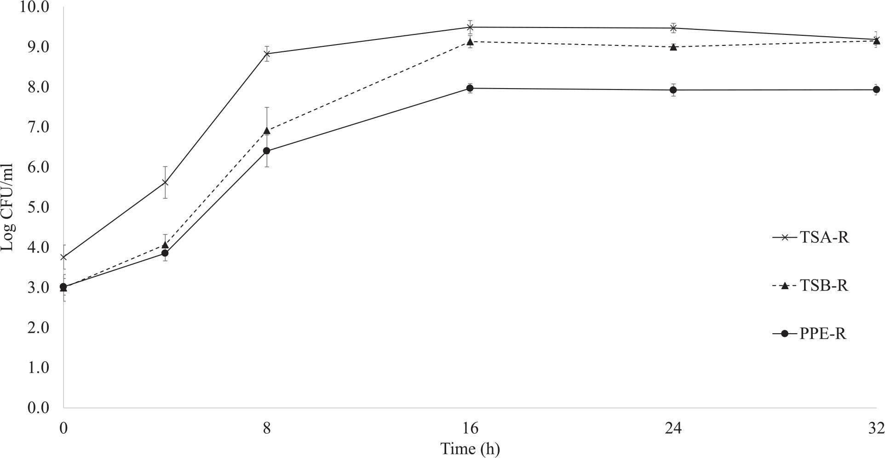
Average growth of E. coli TVS 353 in tryptic soy agar, tryptic soy broth, and poultry pellet extract growth media
Growth media significantly affected the E. coli TVS 353 growth rate. Tryptic soy agar and tryptic soy broth both supported higher E. coli growth rates in media, carrying capacity, and a shorter lag phase compared with poultry pellet extract.
Notes:
Discuss the differences in growth rates:
Tryptic soy agar (TSA) and tryptic soy broth (TSB) supported higher growth rates and carrying capacities compared to poultry pellet extract (PPE).
Explain the role of nutrient availability:
TSA and TSB are designed for optimal E. coli growth, accounting for the differences observed.

Slide 4
Average growth of E. coli TVS 353 in tryptic soy agar, tryptic soy broth, and poultry pellet extract growth media
These similarities may be attributed to available nutrients between the growth mediums, as tryptic soy agar and tryptic soy broth are developed for optimal growth conditions of E. coli.
Notes:
Detail survival patterns in soil:
Populations remained stable for the first three days.
Significant declines occurred between days 3 and 14.
Populations stabilized ("tail phase") from days 14 to 42.

Slide 5
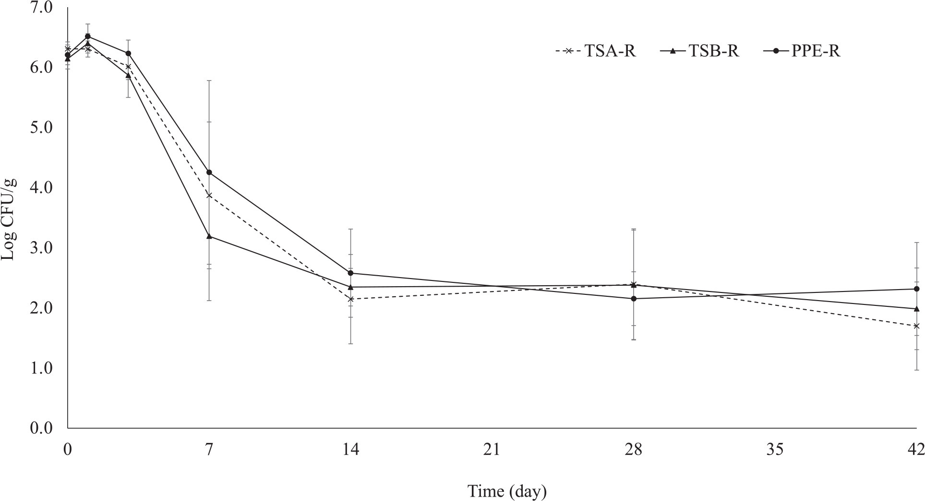
Survival of E. coli TVS 353 in TSA-R, TSB-R, and PPE-R in soil
E. coli populations in soil did not decline until day 3 and then showed significant declines between days 3 and 14 compared with levels seen between days 0 and 3. A tail was observed between 14 and 42 days when E. coli populations were stable.
Notes:
Clarify the minor impact of growth media on early survival patterns (days 0-3).
Emphasize that growth media did not influence the overall duration of survival in soil.

Slide 6
Survival of E. coli TVS 353 in TSA-R, TSB-R, and PPE-R in soil
Although results of the current study did find that growth media slightly impacted the early (days 0 to 3) survival patterns of E. coli TVS 353 in soils, the data do not support that growth media type affected the survival duration of E. coli TVS 353 in soils.
Notes:
Summarize findings:
Growth media affect laboratory growth rates but not long-term survival in soil.
Implications for research:
Findings suggest consistency in survival predictions regardless of the growth media used in experiments.

Slide 7
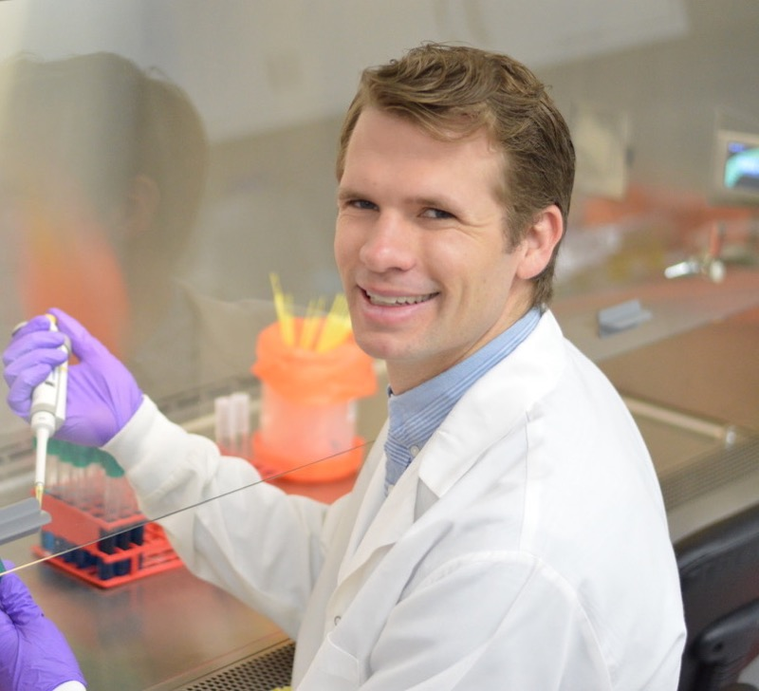
More Information
Check out our paper!
Cameron A. Bardsley
Research Food Technologist
USDA-ARS
cameron.bardsley@usda.gov
Keith R. Schneider
Professor of Food Science
University of Florida
keiths29@ufl.edu
This work is supported by the Specialty Crops Research Initiative [grant no. 2020-51181-32157] from the USDA National Institute of Food and Agriculture. Any opinions, findings, conclusions, or recommendations expressed in this presentation are those of the speakers and do not necessarily reflect the view of the U.S. Department of Agriculture.
Notes:
Acknowledge USDA's Specialty Crops Research Initiative funding.
Provide contact information for Cameron A. Bardsley and Keith R. Schneider.
Encourage attendees to refer to the related publication for comprehensive results.

