Slide 1
Research Updates: Objective 1
Efficacy of Peracetic Acid and Chlorine on the Reduction of Shiga Toxin-producing Escherichia coli and a Nonpathogenic E. coli Strain in Preharvest Agricultural Water
Notes:
Begin by welcoming the audience and introducing the topic: "Efficacy of Peracetic Acid and Chlorine on the Reduction of Shiga Toxin-producing E. coli in Preharvest Agricultural Water."
Mention the importance of preharvest water safety in agriculture.
Acknowledge the contribution of the USDA's Specialty Crops Research Initiative.

Slide 2
Research Highlights
Contact time and sanitizer type influenced STEC and E. coli TVS 353 reductions.
STEC panel was more sensitive to chlorine and peracetic acid than E. coli TVS 353.
All Cl treatments achieved ≥3 log10 CFU/100 mL reduction in STEC and E. coli TVS 353.
E. coli TVS 353 is a good surrogate candidate for in-field experiment validations.
Water quality management is important to maintain residual sanitizer concentrations.
Notes:
Discuss the study's primary focus: analyzing the efficacy of chlorine and peracetic acid (PAA) in reducing Shiga toxin-producing E. coli (STEC) and a surrogate strain (E. coli TVS 353).
Highlight key findings:
Both sanitizer type and contact time significantly impacted E. coli reductions.
Chlorine was particularly effective, achieving ≥3 log10 CFU/100 mL reduction in all cases.
E. coli TVS 353 is a robust surrogate for field experiments.
Emphasize the need for good water quality to maintain sanitizer effectiveness.

Slide 3
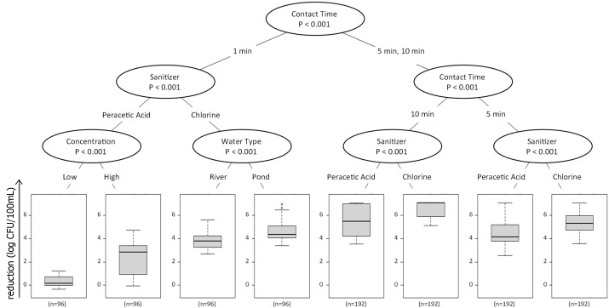
Effect of Interactions Between Factors on E. coli Reductions
Contact time had the largest effect on both Shiga-toxin producing E. coli (STEC) and Generic E. coli (TVS 353) concentrations.
Sanitizer type was of second greatest importance after contact time, with chlorine resulting in greater reductions in STEC and E. coli TVS 353 compared to peracetic acid (PAA).
Notes:
Explain that contact time was the most critical factor in reducing E. coli concentrations, with sanitizer type as the second most important.
Clarify that chlorine consistently outperformed PAA in both STEC and E. coli TVS 353 reductions.
Provide examples to illustrate these differences.

Slide 4
Effect of Interactions Between Factors on E. coli Reductions
While a 1-min contact time was sufficient in reducing E. coli levels by the 3 log10 CFU/100 mL acceptance criteria for all Cl-based treatment combinations, an extended contact time was needed for the majority of the PAA-based treatment combinations.
Notes:
Note that while chlorine treatments met the ≥3 log10 CFU/100 mL reduction threshold within 1 minute, most PAA treatments required longer contact times.
Stress the practical implications of these findings for real-world agricultural settings.

Slide 5
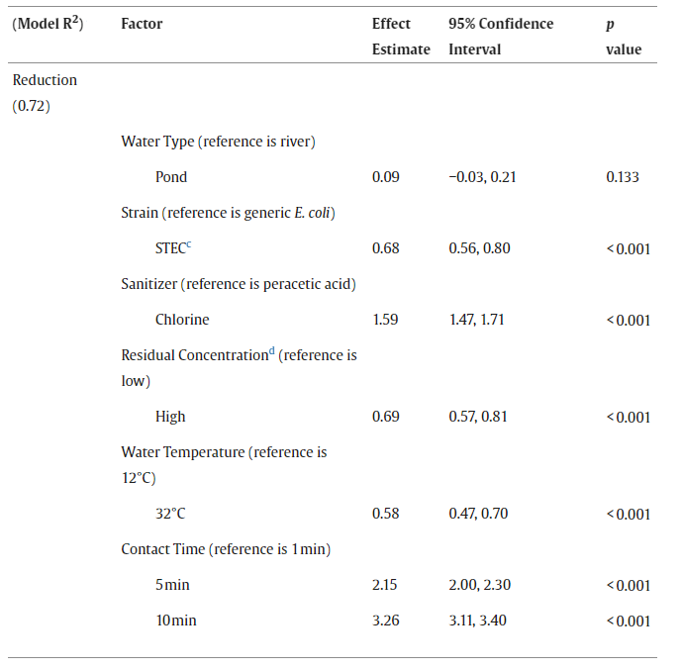
Results of the Log-linear Model Characterizing the Reductions in E. coli Concentration
The STEC panel was more sensitive to sanitizer treatment compared to the E. coli TVS 353 strain.
Our findings suggest E. coli TVS 353 appears to be a conservative surrogate for in-field experiments, since it possesses similar but slightly more resistant survival characteristics, compared to the STEC panel.
Notes:
Discuss the sensitivity differences between STEC and E. coli TVS 353 to sanitizer treatments.
Highlight the conclusion that E. coli TVS 353 is a conservative surrogate due to its slightly higher resistance compared to STEC.
Emphasize how this finding supports the use of E. coli TVS 353 for in-field validation experiments.

Slide 6
More Information
Check out our paper!
Claire M. Murphy, Ph.D.
Assistant Professor and Extension Specialist
Washington State University
claire.murphy@wsu.edu
Laura K. Strawn, Ph.D.
Associate Professor
Virginia Tech
laurakstrawn@vt.edu
This work is supported by the Specialty Crops Research Initiative [grant no. 2020-51181-32157] from the USDA National Institute of Food and Agriculture. Any opinions, findings, conclusions, or recommendations expressed in this presentation are those of the speakers and do not necessarily reflect the view of the U.S. Department of Agriculture.
Notes:
Acknowledge the USDA and the Specialty Crops Research Initiative for funding support.
Invite attendees to read the associated research paper for a deeper dive into the findings.
Provide contact details for Dr. Claire Murphy and Dr. Laura Strawn for further questions or collaboration opportunities.

